Slide 1





Managed Services to Simplify Cloud Access for Computer Science Research and Education
PEARC 2020
July 27, 2020
Mike Norman, PI
Shava Smallen, Co-PI
Vince Kellen, Co-PI
David Culler, Co-PI
NSF Award: 1925001
Ed Lazowska, Co-PI
Deep Medhi, PO

Slide 2
CloudBank project team
UC San Diego/SDSC: Mike Norman (PI), Vince Kellen (Co-PI), Shava Smallen (Co-PI), Brian DeMeulle, Declan Fleming, Paul Hoover, Kate Kaya, Nick Marangella, Sonia Nayak, Amin Qazi, Jessica Respicio, Shawn Strande, Mary Thomas, Nicole Wolter, Choonhan Youn, Frank Wuerthwein
University of Washington: Ed Lazowska (Co-PI), Rob Fatland, Sarah Stone, Amanda Tan
UC Berkeley: David Culler (Co-PI), James Percy
Strategic Blue: James Mitchell, Jon Bryant, Frank Contrepois, Steve Old, Emma Sampayo, Hitesh Shah, James Smith
External Advisory Board: Dana Brunson (Chair), Maytal Dahan, Dennis Gannon, Tracy Camp, Tracy Futhey, Michael Franklin, Jason Liu
Cloud providers: AWS, GCP, Azure. IBM coming early 2021.
National Science Foundation: Deep Medhi

Slide 3



CloudBank 101
5-year pilot project, funded by via a $5M NSF Cooperative Agreement
Goal: Make it easier for CISE researchers and educators to use the public cloud
The project is organized into 3 main efforts
User Portal
UCSD/SDSC
Education & Training
UW & UCB
Financial Management
UCSD/ITS & Strategic Blue

Slide 4
CloudBank is focused initially on specific NSF CISE solicitations
IMPORTANT SCOPE: Only specific NSF solicitations are eligible for cloud resources through CloudBank. The solicitation will state eligibility explicitly.
There have been 2 such solicitations so far
Smart and Connected Communities (Closed)
Cyber-Physical Systems (Open: Medium closed, Frontier till Dec 2nd)
PIs request cloud resources in a Supplementary Document, not the formal budget. Cloud funding does not pass through the awardee institution
The total of your formal budget request and the cloud request must not exceed the total allowable request for the solicitation.
Cloud resources are free of indirect costs. I.e., are treated like equipment
Without CloudBank institutions would add cloud funding to their budget and many would pay indirect costs.

Slide 5
CloudBank seeks to address pain points of researchers and educators using public cloud
“Setting up your first experiment in the cloud is too time-consuming, and different for each cloud platform.”
“Cloud is just not designed for typical use case of a small research group.”
“I need documentation specific to my research.”
“We need an expedited process for setting up experiments very quickly. Often we use cloud resources when we're on a deadline so quick setup is critical.”
“Provisioning all students in a class with their own cloud credits and dealing with their cost overruns is a major pain. Financial losses can be substantial if students are given free reign.”
“I just don’t have enough time to learn all this. Can you give me a jump start?”
“There is no simple way to run multiple experiments with software already installed in one instance.
“It’s a Hobson’s choice between giving everyone root access or losing my life in fine-tuning access.”
“Cloud is a serious learning curve. Just too much documentation, and of the wrong type. Students get lost.
“Research credits are difficult for us to keep track of.”
“We need billing help. It’s opaque as to what is going on and I don’t have the time to wade through this.”

Slide 6
CloudBank seeks to address pain points of researchers and educators using public cloud
“Setting up your first experiment in the cloud is too time-consuming, and different for each cloud platform.”
“Cloud is just not designed for typical use case of a small research group.”
“I need documentation specific to my research.”
“We need an expedited process for setting up experiments very quickly. Often we use cloud resources when we're on a deadline so quick setup is critical.”
“Provisioning all students in a class with their own cloud credits and dealing with their cost overruns is a major pain. Financial losses can be substantial if students are given free reign.”
“I just don’t have enough time to learn all this. Can you give me a jump start?”
“There is no simple way to run multiple experiments with software already installed in one instance.
“It’s a Hobson’s choice between giving everyone root access or losing my life in fine-tuning access.”
“Cloud is a serious learning curve. Just too much documentation, and of the wrong type. Students get lost.
“Research credits are difficult for us to keep track of.”
“We need billing help. It’s opaque as to what is going on and I don’t have the time to wade through this.”

Slide 7
CloudBank seeks to address pain points of researchers and educators using public cloud
“Setting up your first experiment in the cloud is too time-consuming, and different for each cloud platform.”
“Cloud is just not designed for typical use case of a small research group.”
“I need documentation specific to my research.”
“We need an expedited process for setting up experiments very quickly. Often we use cloud resources when we're on a deadline so quick setup is critical.”
“Provisioning all students in a class with their own cloud credits and dealing with their cost overruns is a major pain. Financial losses can be substantial if students are given free reign.”
“I just don’t have enough time to learn all this. Can you give me a jump start?”
“There is no simple way to run multiple experiments with software already installed in one instance.
“It’s a Hobson’s choice between giving everyone root access or losing my life in fine-tuning access.”
“Cloud is a serious learning curve. Just too much documentation, and of the wrong type. Students get lost.
“Research credits are difficult for us to keep track of.”
“We need billing help. It’s opaque as to what is going on and I don’t have the time to wade through this.”

Slide 8
CloudBank seeks to address pain points of researchers and educators using public cloud
“Setting up your first experiment in the cloud is too time-consuming, and different for each cloud platform.”
“Cloud is just not designed for typical use case of a small research group.”
“I need documentation specific to my research.”
“We need an expedited process for setting up experiments very quickly. Often we use cloud resources when we're on a deadline so quick setup is critical.”
“Provisioning all students in a class with their own cloud credits and dealing with their cost overruns is a major pain. Financial losses can be substantial if students are given free reign.”
“I just don’t have enough time to learn all this. Can you give me a jump start?”
“There is no simple way to run multiple experiments with software already installed in one instance.
“It’s a Hobson’s choice between giving everyone root access or losing my life in fine-tuning access.”
“Cloud is a serious learning curve. Just too much documentation, and of the wrong type. Students get lost.
“Research credits are difficult for us to keep track of.”
“We need billing help. It’s opaque as to what is going on and I don’t have the time to wade through this.”

Slide 9
CloudBank provides managed services to address these pain points
Cloud solution consulting, cloud training, proposal assistance
Onboarding, account setup, user management, off-boarding
Tools for PIs to grant permissions to research group members and students
Unified reporting across cloud providers
Bundling multiple small requests into a bulk request to cloud providers, providing leverage to secure discounts
Pass along savings to researchers

Slide 10










CloudBank workflow
Researchers & Institutions
Cloud research
Education Outreach Education Training
Proposals to CloudBank-eligible solicitations
Award funds
PI and user
accounts
Usage reporting
Pay cloud providers
Pay Strategic Blue
Cloud funds

Slide 11
You request cloud resources via a Supplementary document in your NSF proposal
From the current Cyber-Physical Systems Solicitation:
“If requesting cloud computing resources, include a description of your requests (not to exceed 2 pages) that includes:
title of the proposal;
the total cost of computing resources, with yearly breakdown;
which public cloud providers will be used; and
a technical description and justification of the request, along with how the cost was estimated.”
That sounds easy, right?
But there are hundreds of offerings across the providers and figuring out what to use for your research can be confusing!

Slide 12
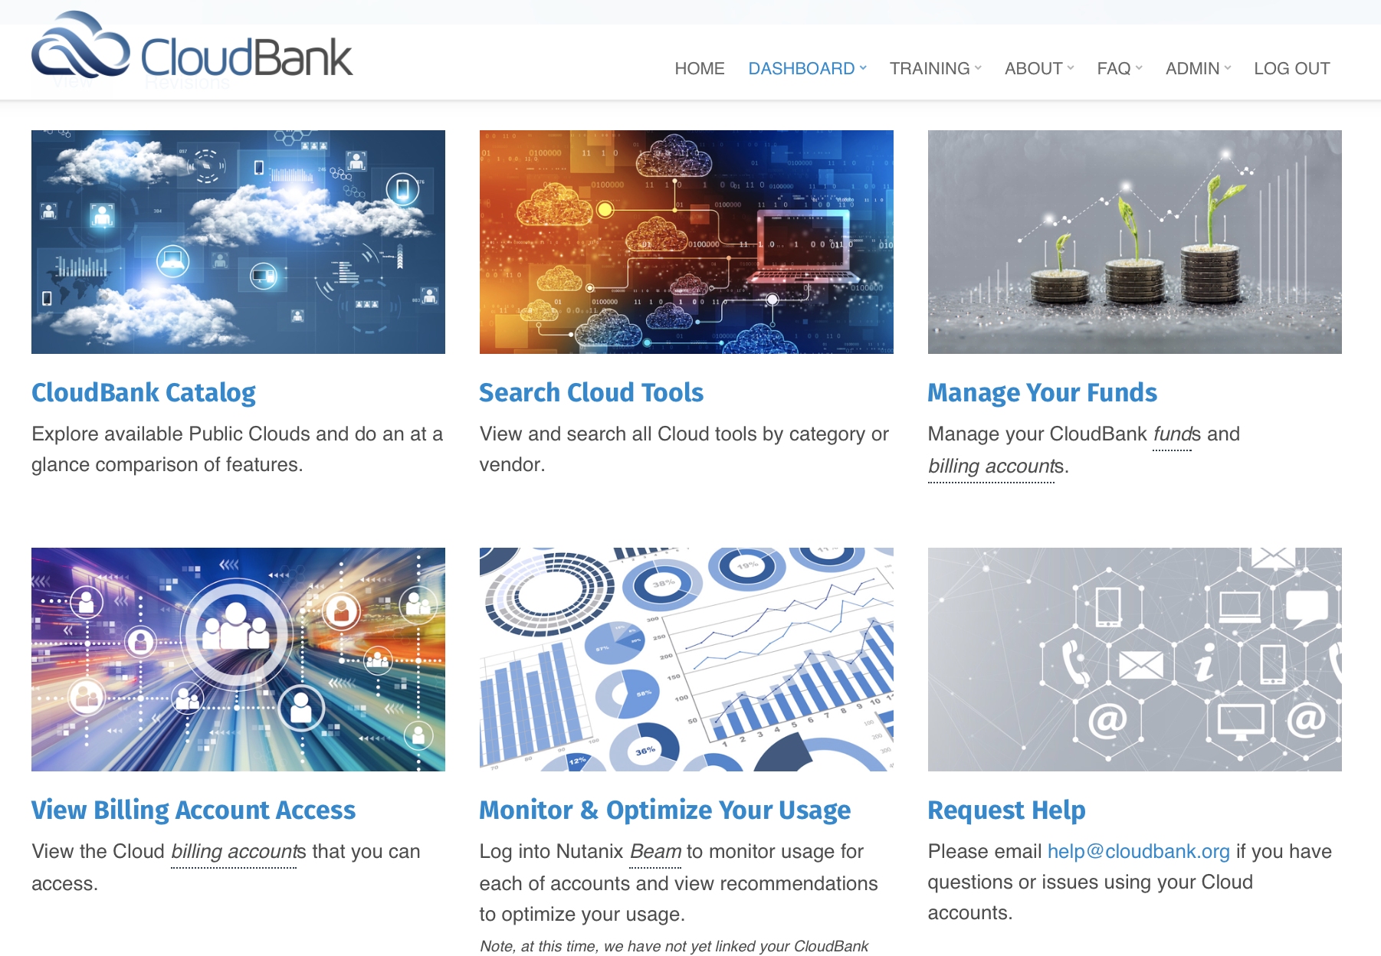
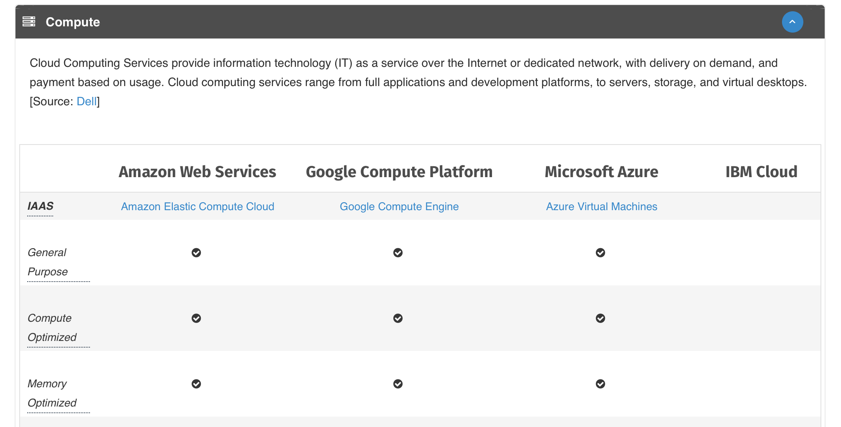
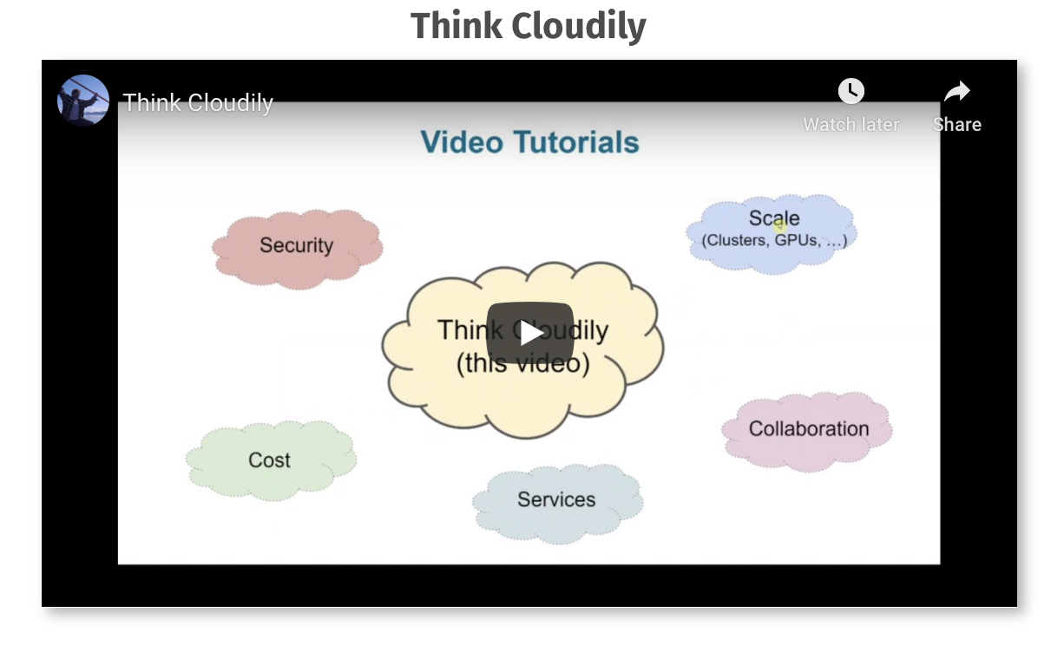
CloudBank can help you understand the public cloud, with training materials, side-by-side comparisons of provider offerings and educational resources
If you still need help, the CloudBank support team can help.
help@cloudbank.org
And if we can’t help, there are options:
We work with cloud providers on your behalf
Groups like Campus Champions are a great resource
You may have people from providers that work with your campus.

Slide 13
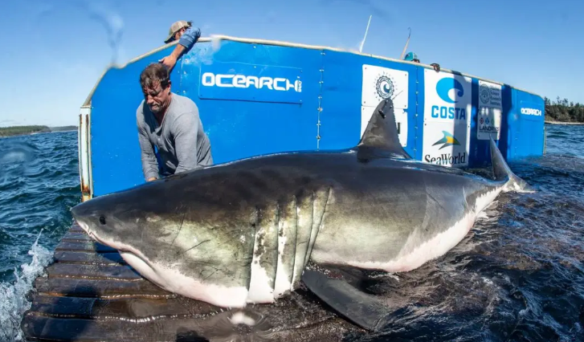

Slide 14
Research Arc
Open use
(tools, data)
Ideas, Questions!
Exit
Strategy
Ideas, Questions!
Research Team Roles
Principal Investigator
Cloud Administrator
Builder
Researcher
Networking
Tech
Review
Provision
Proposal
Costing
Curriculum
Research!
Data Management Plan
Load in
Onboard
Cost
Mgmt
Commit
Role-based
training
Roles
Startup

Slide 15
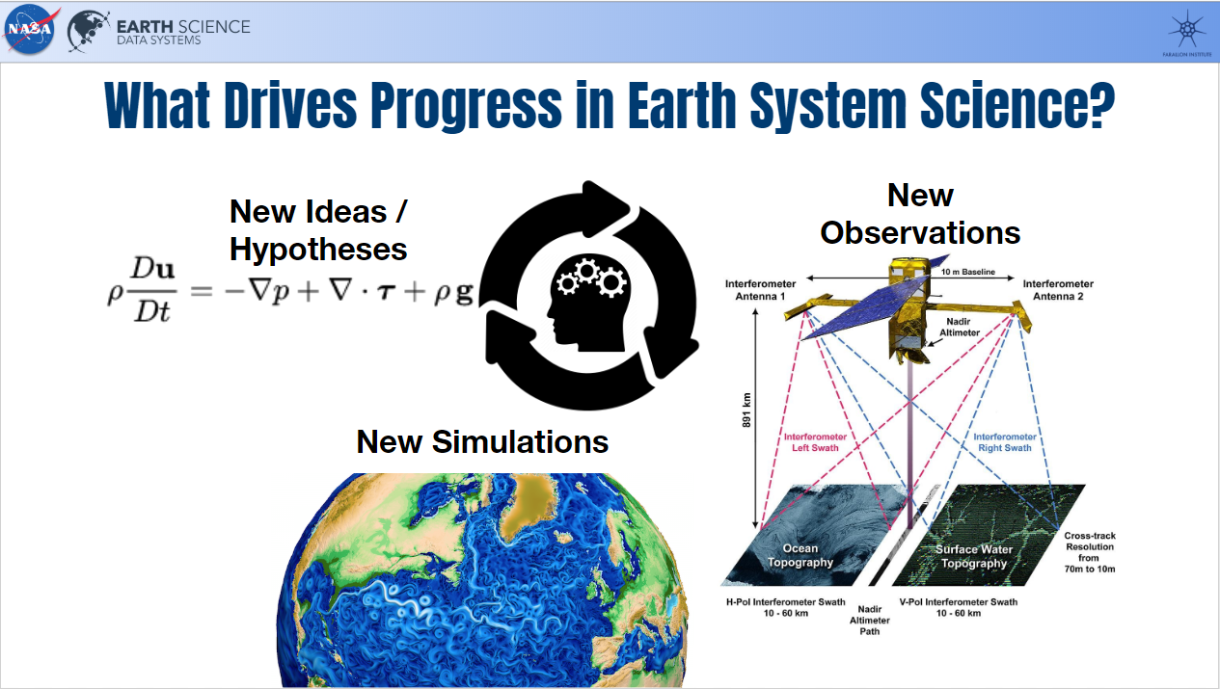
slide courtesy Chelle Gentemann, thanks!

Slide 16
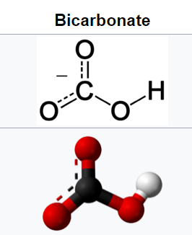
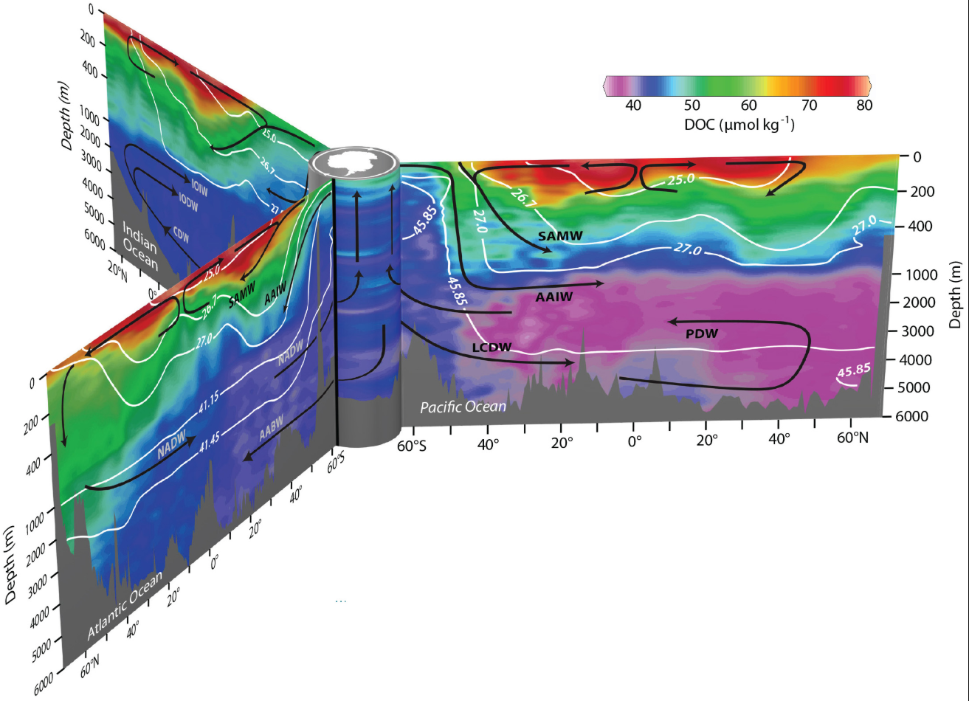

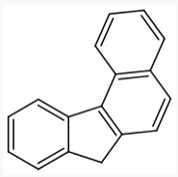
(India)
Pacific Ocean
Atlantic Ocean
Also nutrients: N, Fe, P, ...

Slide 17

‘Small team’ narrative
Computers: Boxes → a meta-programmable resource pool (‘cloud’)
This implies a learning path
Access… Portal to CLI to API
Build… 10% solution
Scale… AMI to K8
Security…
Services...
How to collaborate…
Manage cost...
Convinced? Throw the switch! (and take notes)

Slide 18

Scientists resourceful new datasets
...caught out when it comes to analysis
computer scientists, information technologists invited in
...uh oh… a dearth of computer scientists and RSEs?
Beyond the research team: Science infrastructure on the cloud

Slide 19
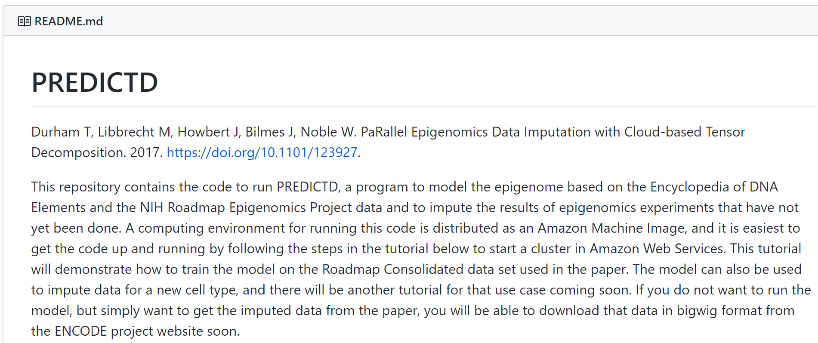
Machine Images
PREDICTD is most readily available on Amazon Web Services as part of an Amazon Machine Image (AMI) called PREDICTD (ami-e7b5439f).

Slide 20





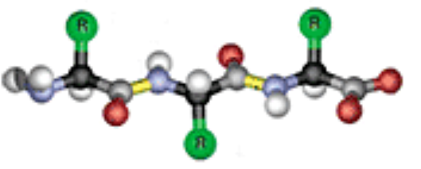
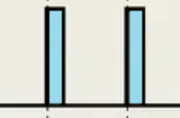



Sub-topics of Navigating Cloud-based Research
turnkey
...or not
$torage
iteration
HPC
complexity
TTL
trust
cost
(GPU etc)
breakeven
desert
contracts
open/repro
git jupyter binder
security
MATLAB
credits (non-sus)
zombies

Slide 21
Failure Modes
Keys
Falling Over
Zombies
Load

Slide 22
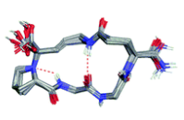
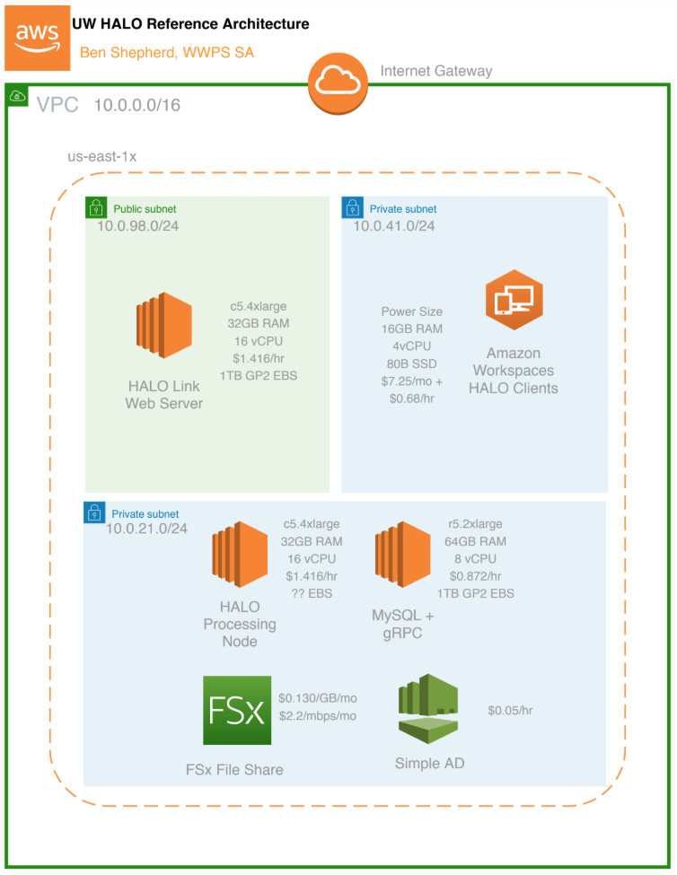
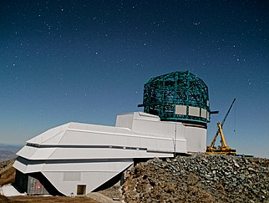
Cloud Training Takeaways
Bespoke and thematic
Always listen, always message costs
Research computing phase transition
Points of impact (why we’re excited)
big data projects
on-demand clusters
aaS
bring compute to data
democratizing science

Slide 23

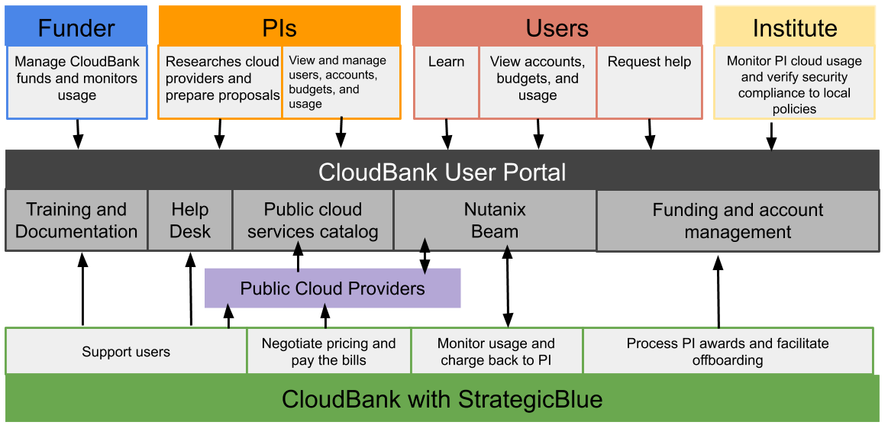



CloudBank User Portal
Datahubs
(UC Berkeley)

Slide 24
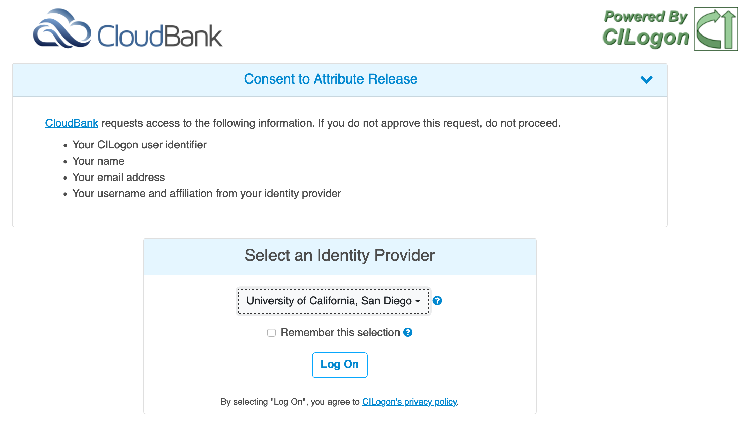

Slide 25
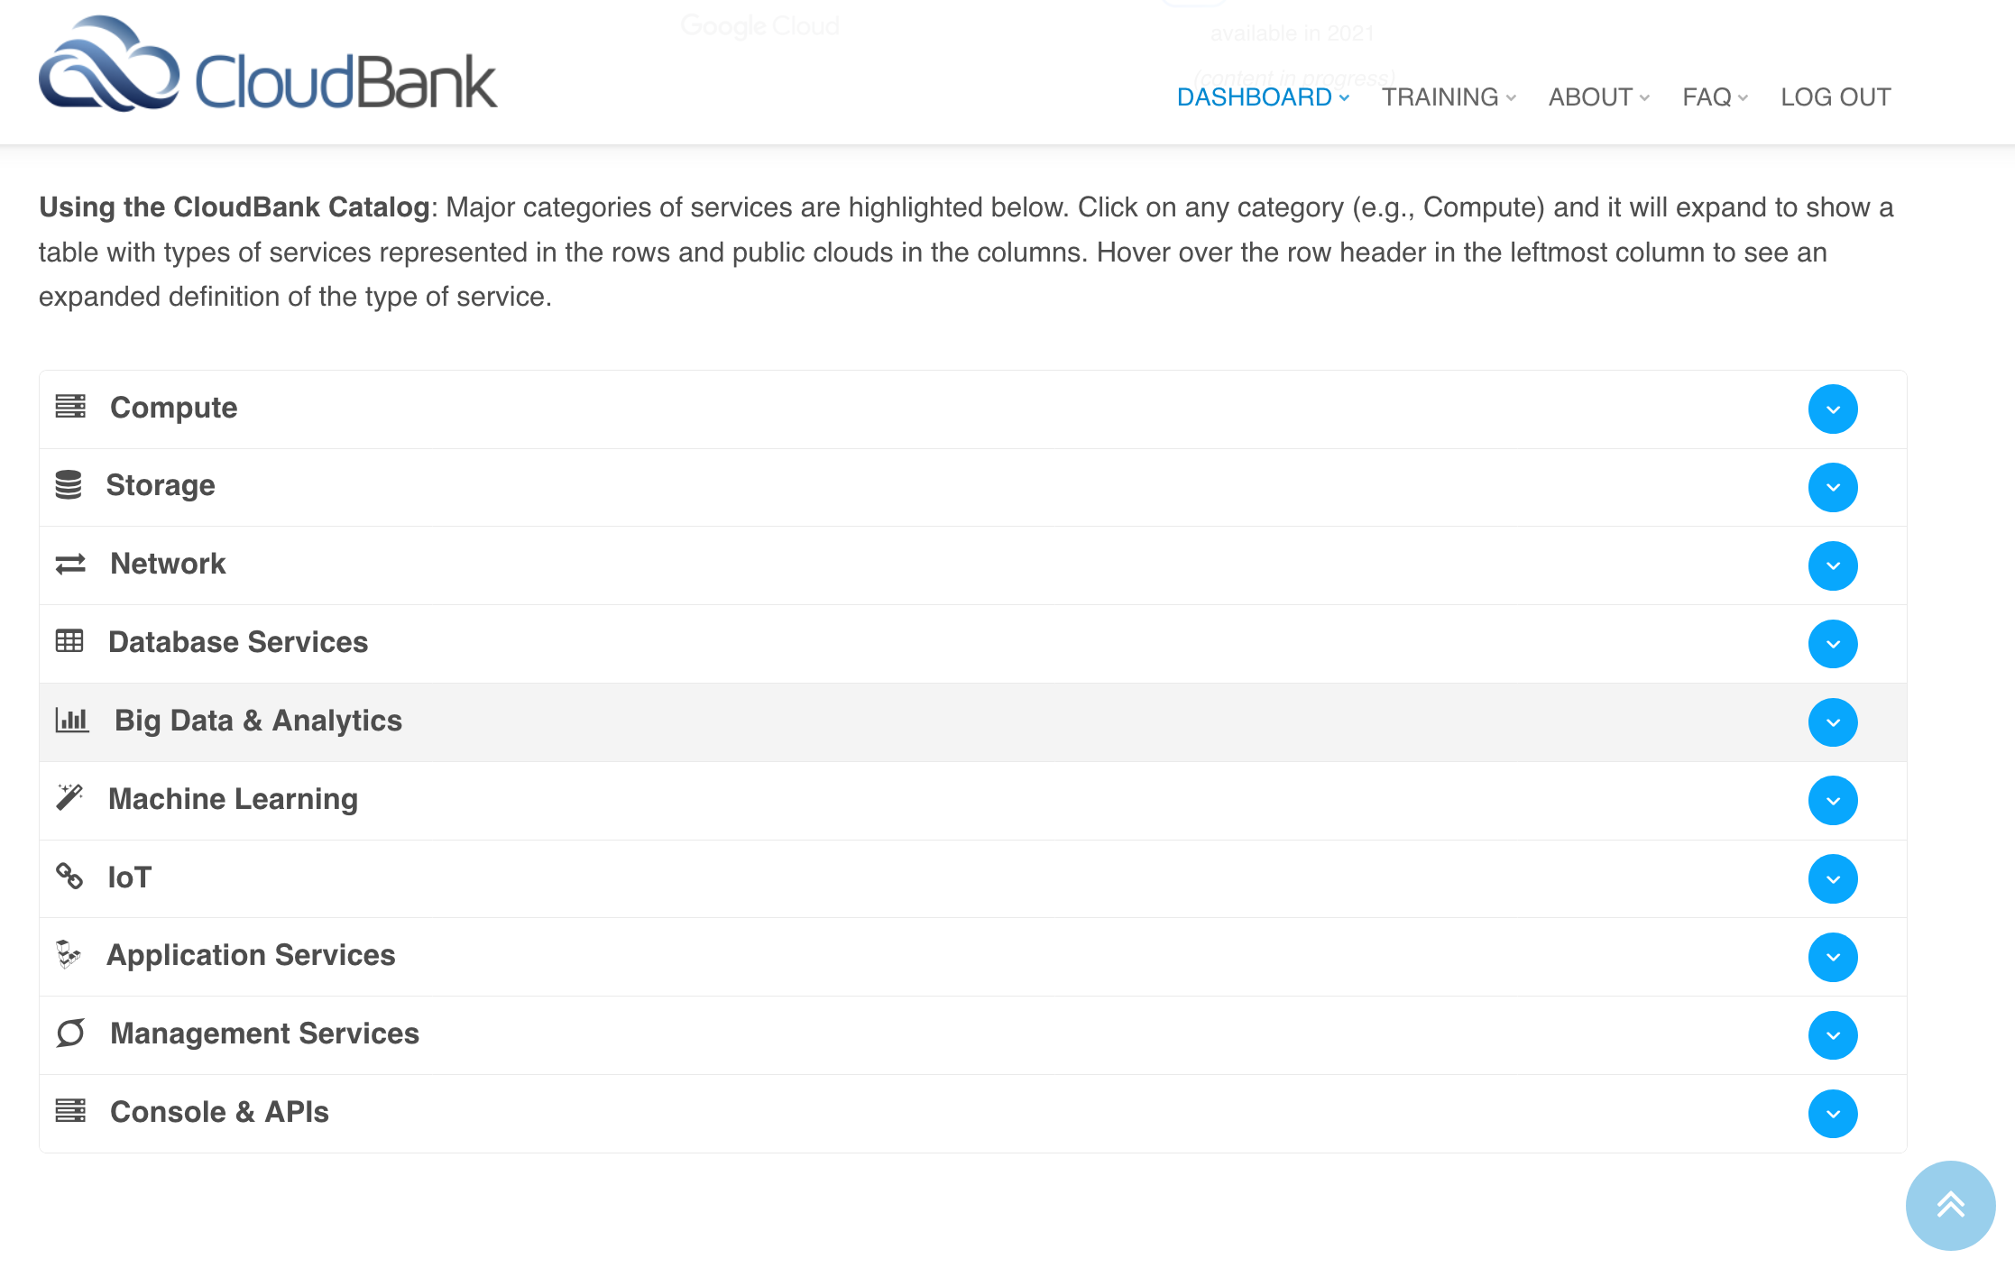

Slide 26
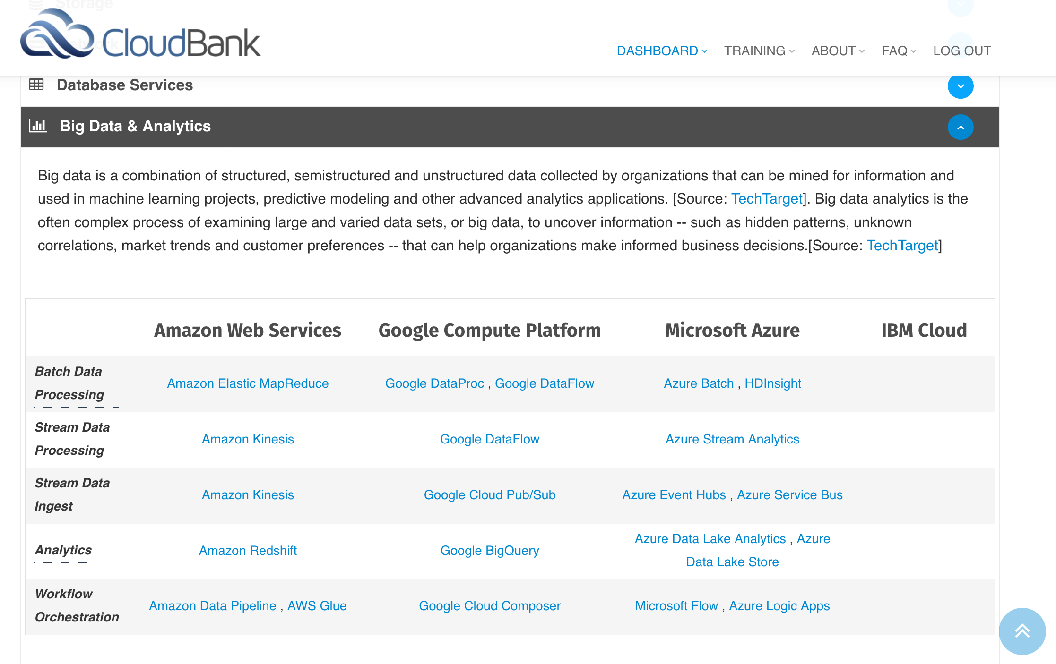

Slide 27
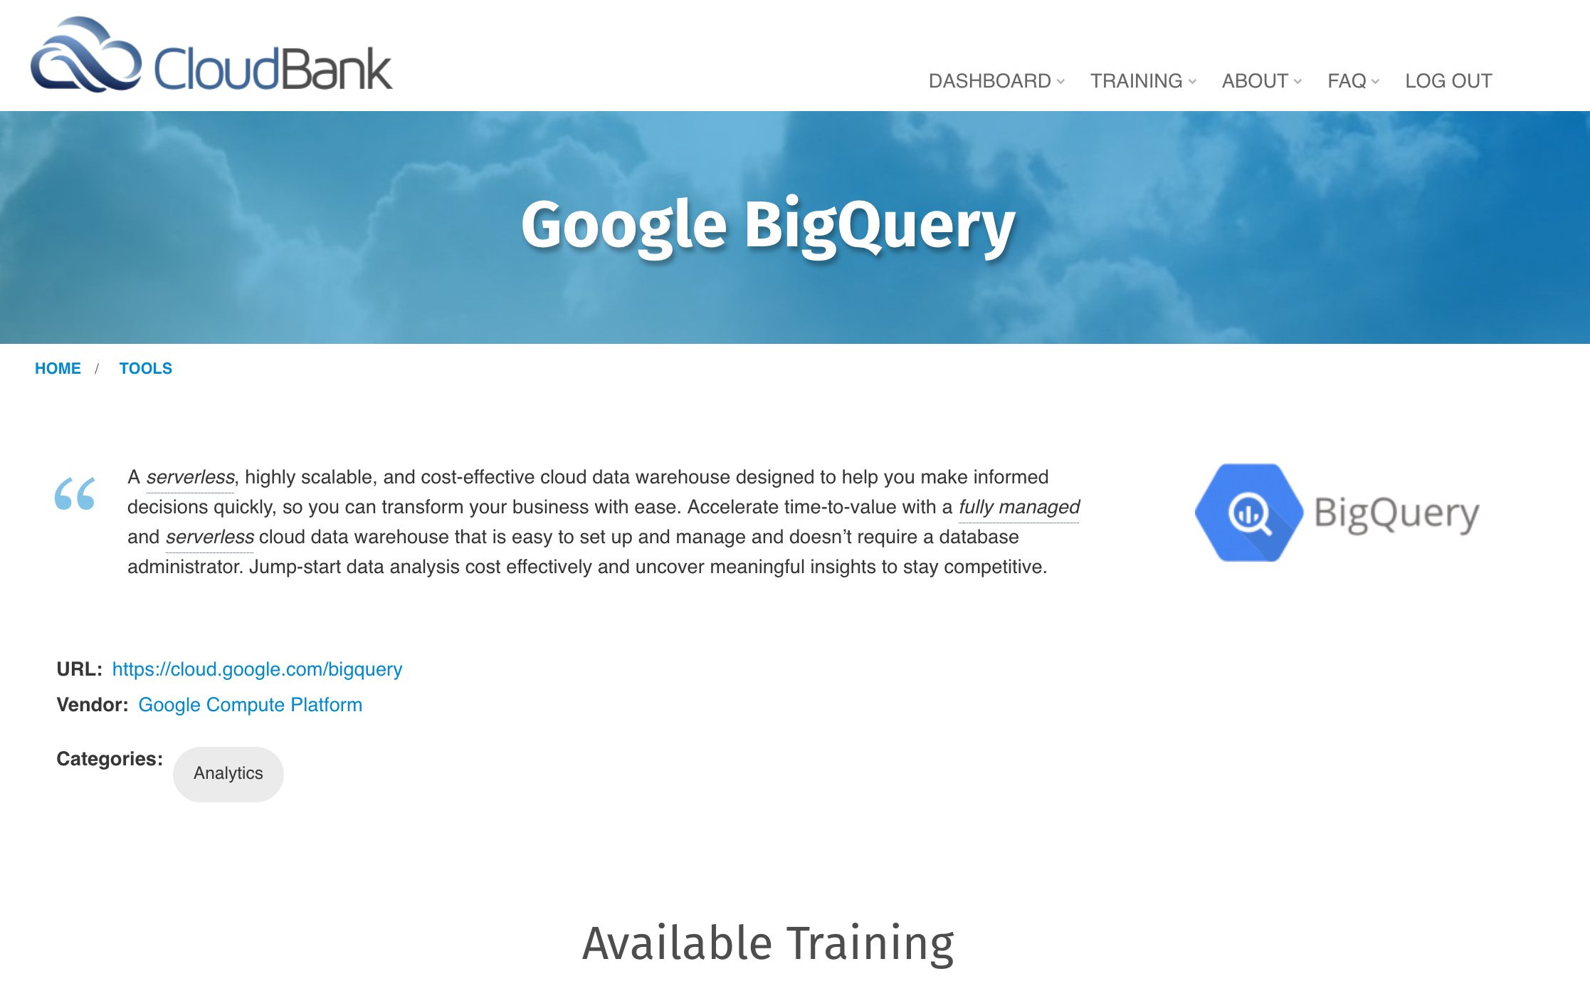

Slide 28
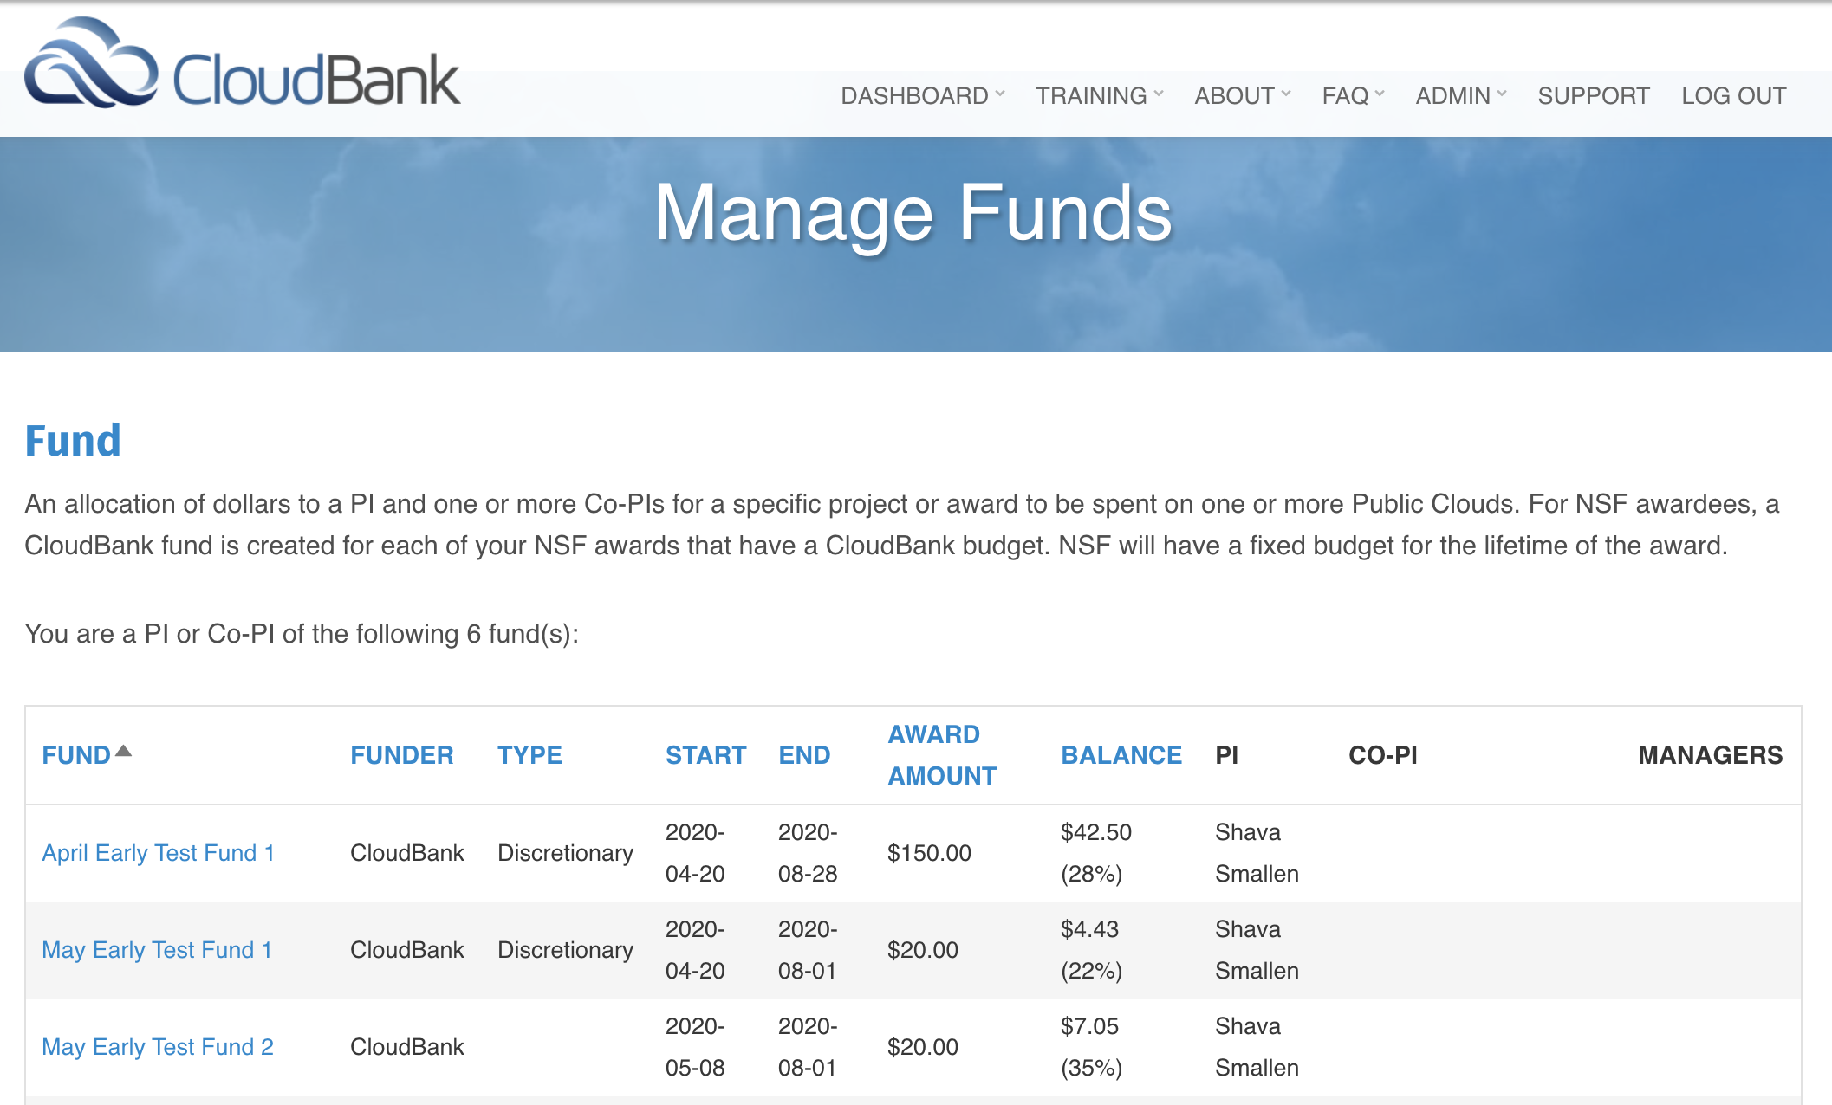
Spend checked hourly but depends on frequency of billing data from each Cloud
Email notifications sent at first 1%, each 10% balance spend, and daily once 20% remains.

Slide 29
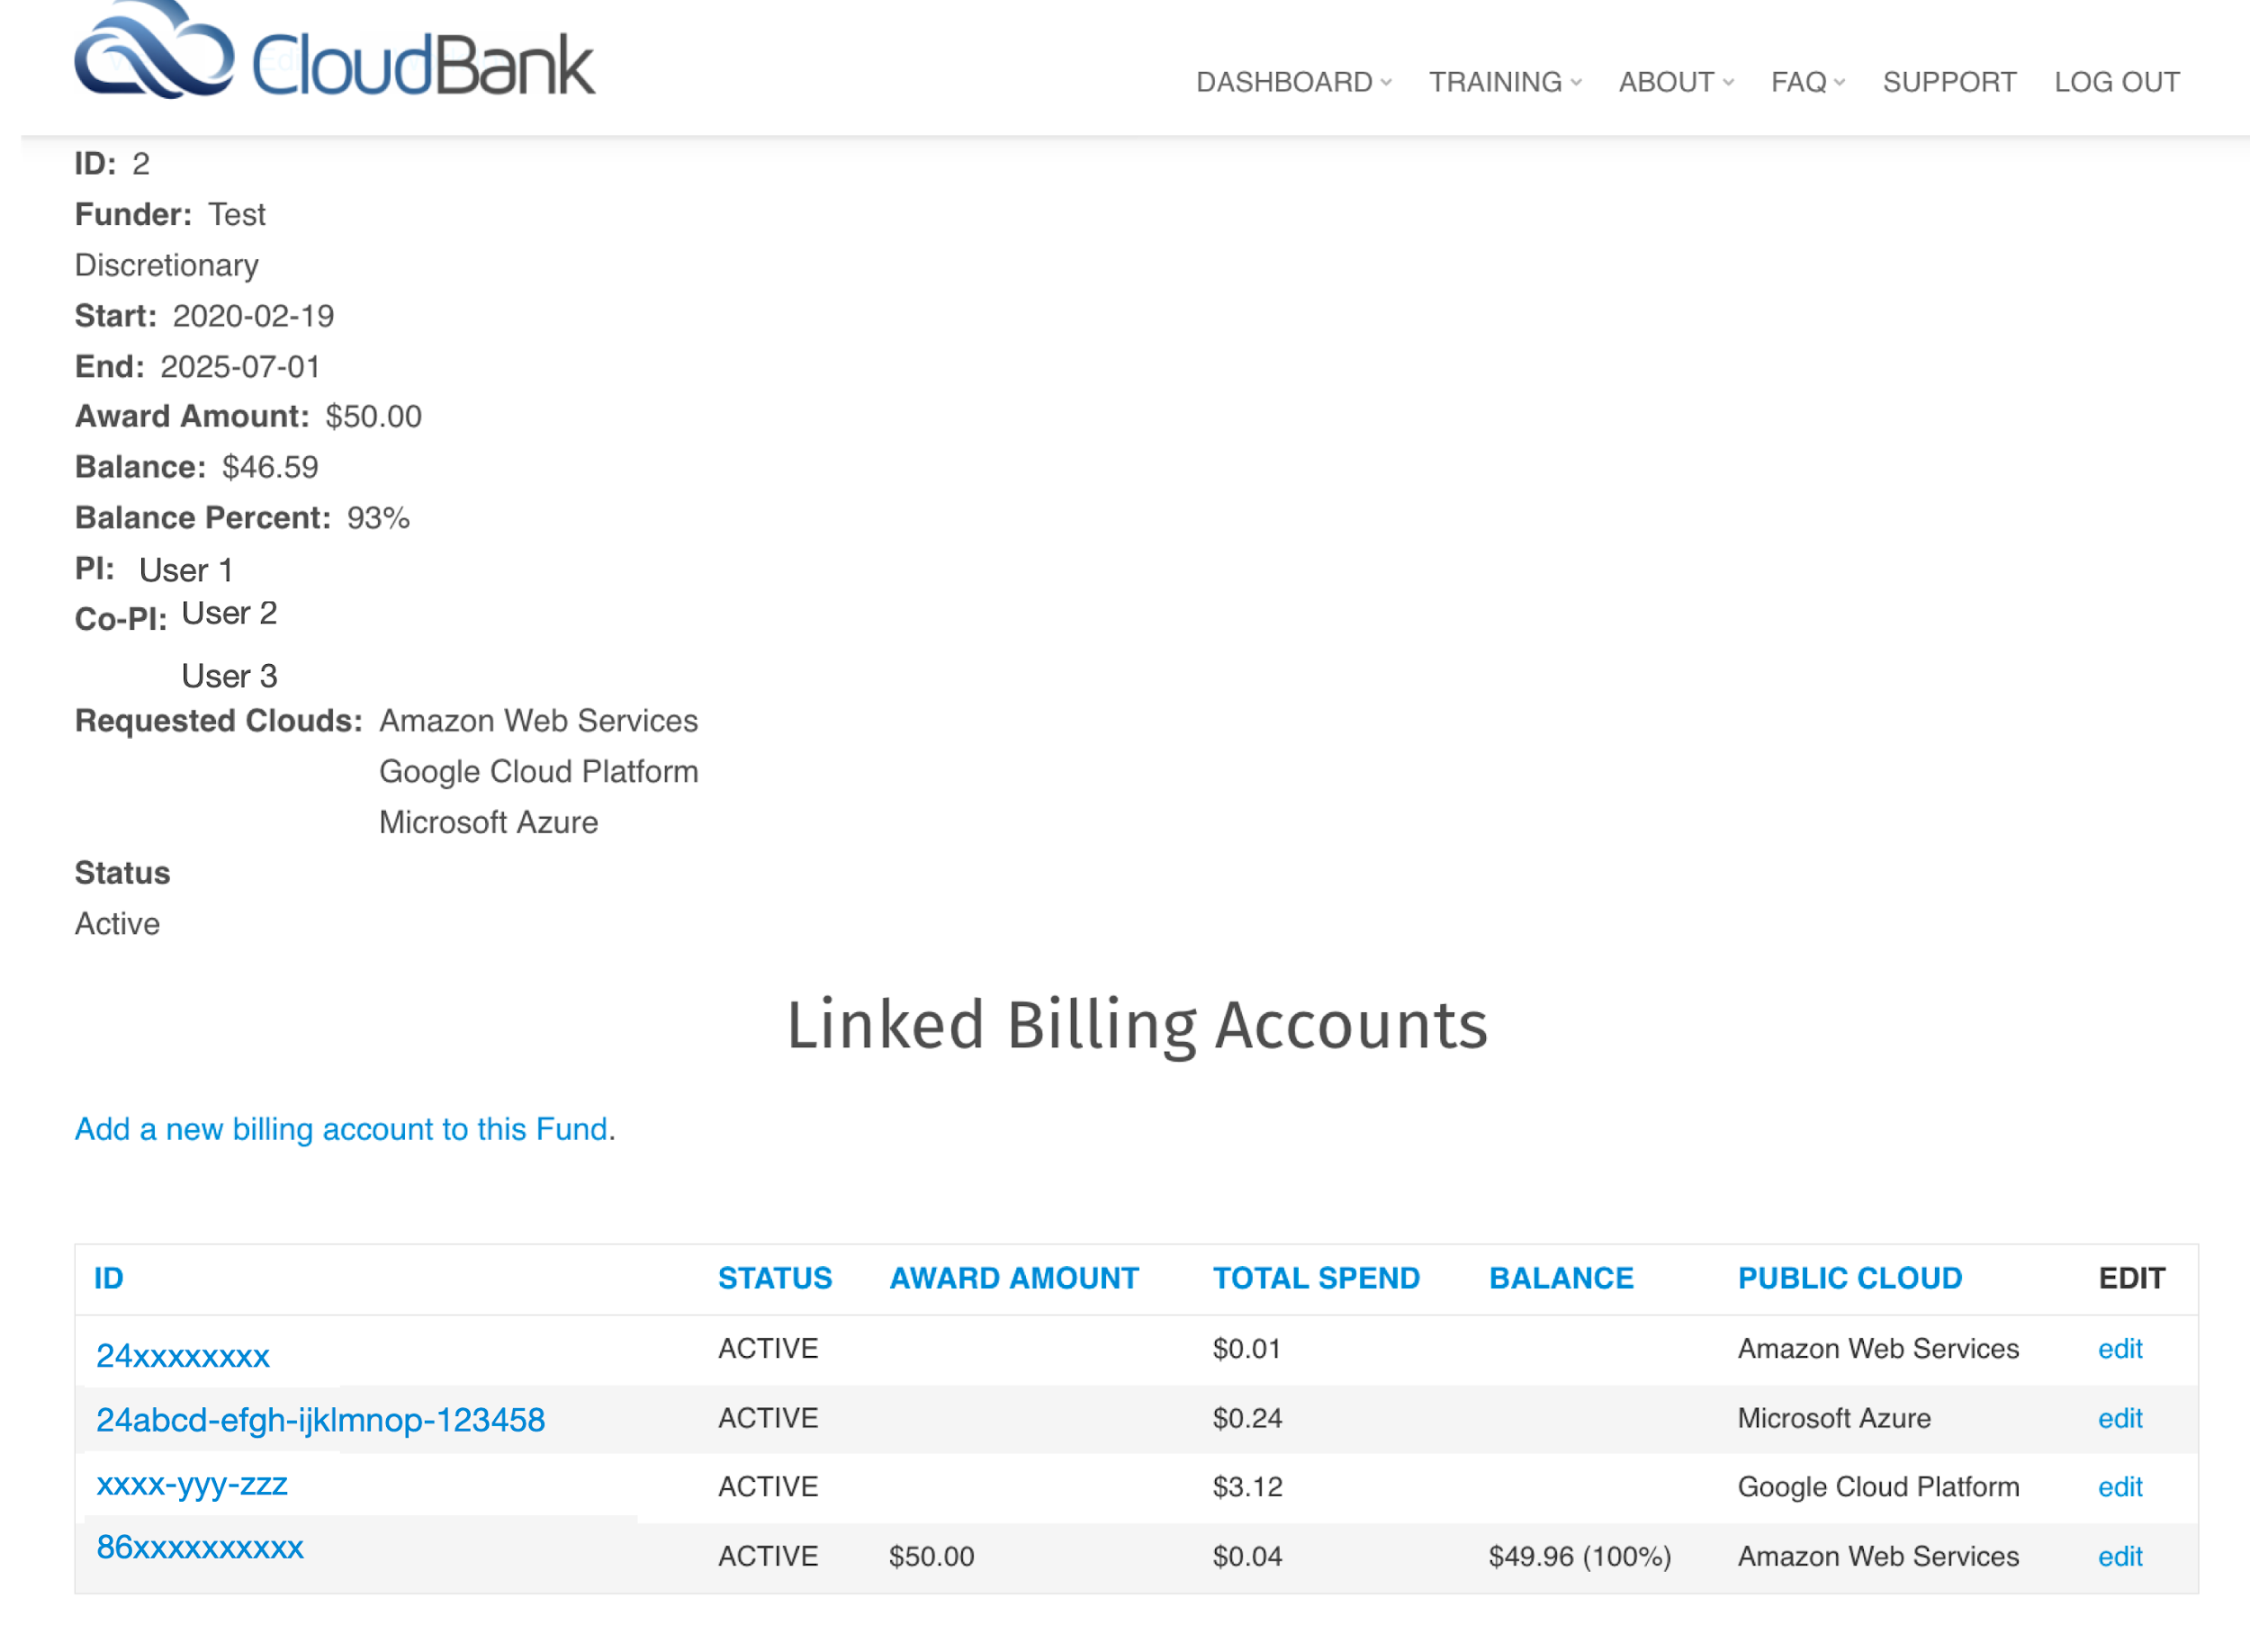
Cloud offerings evolve rapidly, and you can try different providers after your award.
Can spend award in multiple clouds
Click on any linked billing account to manage access

Slide 30
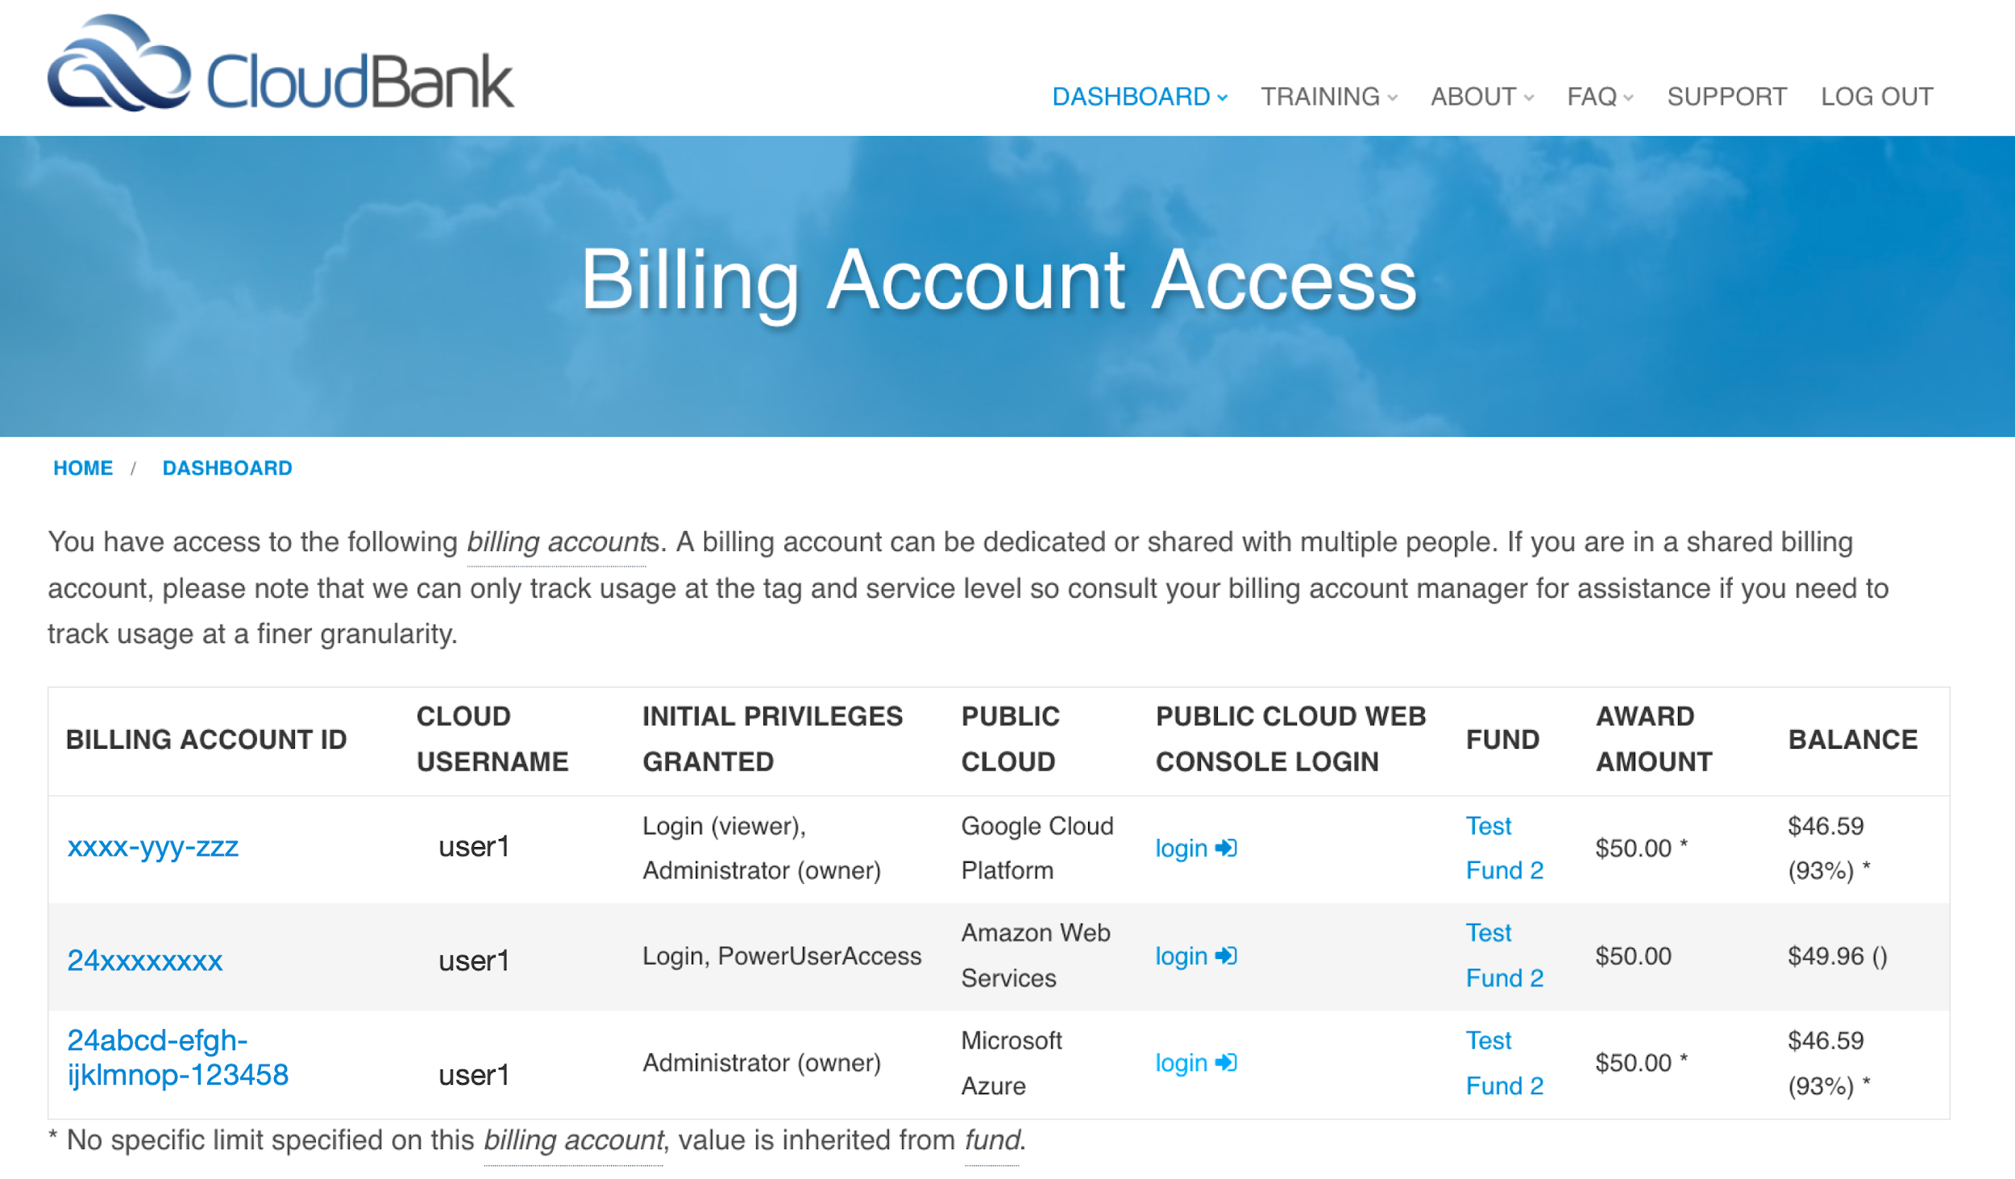
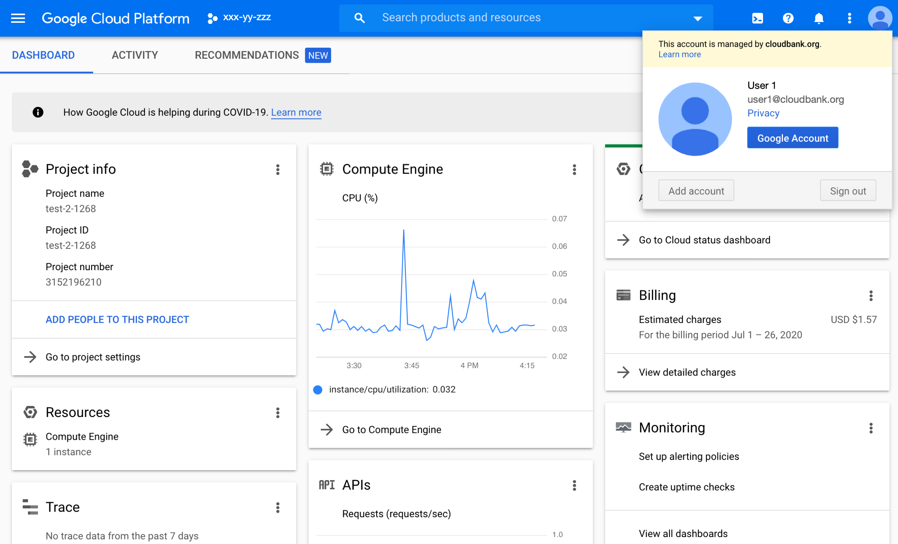
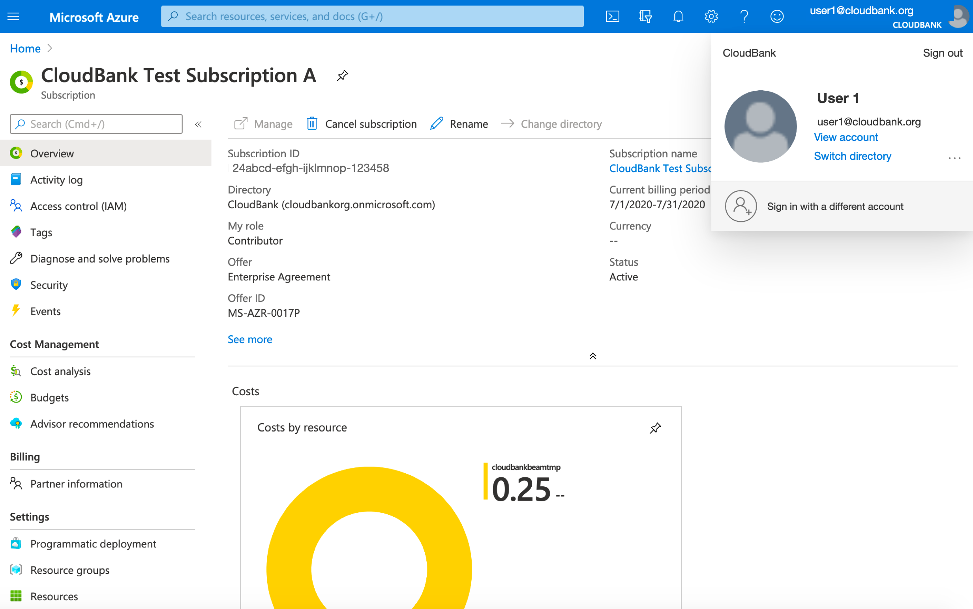
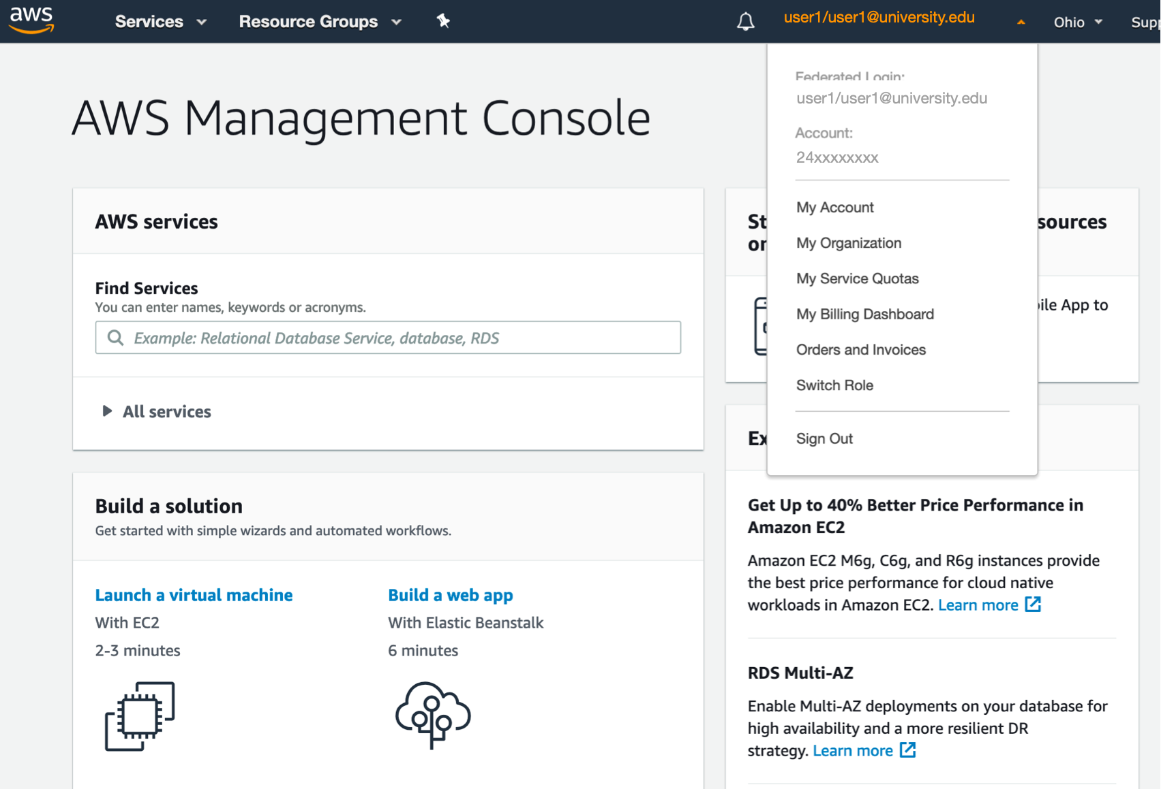
Login to cloud consoles using your institute credentials

Slide 31
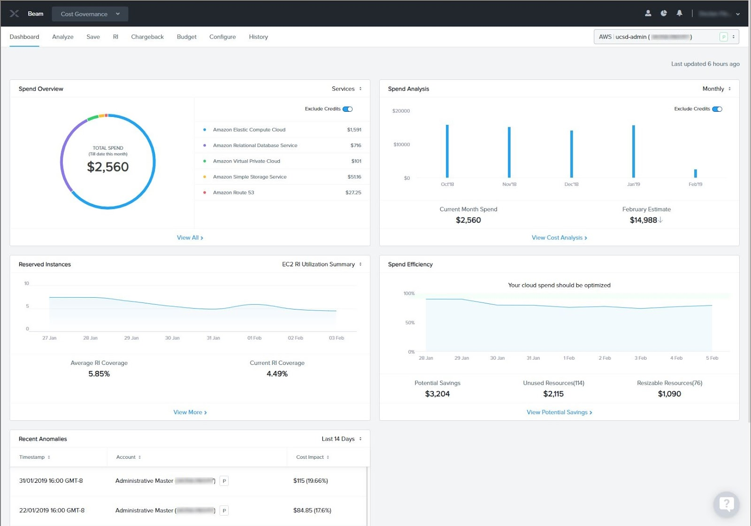
Drill down to identify unused resources (volumes, IPs, etc.)
Monthly spend-to-date by resource type (VM, RDS, etc.)
Historical monthly spending
(also does forecasting)
Identifies when reserved instances will be more cost effective
Spend efficiency (summarizes allocated resources that are either unused or could be reduced in size based on historical usage)
Unusual spikes in cost
Nutanix Beam enables CloudBank to provide PI and user views across multiple accounts across multiple cloud providers

Slide 32
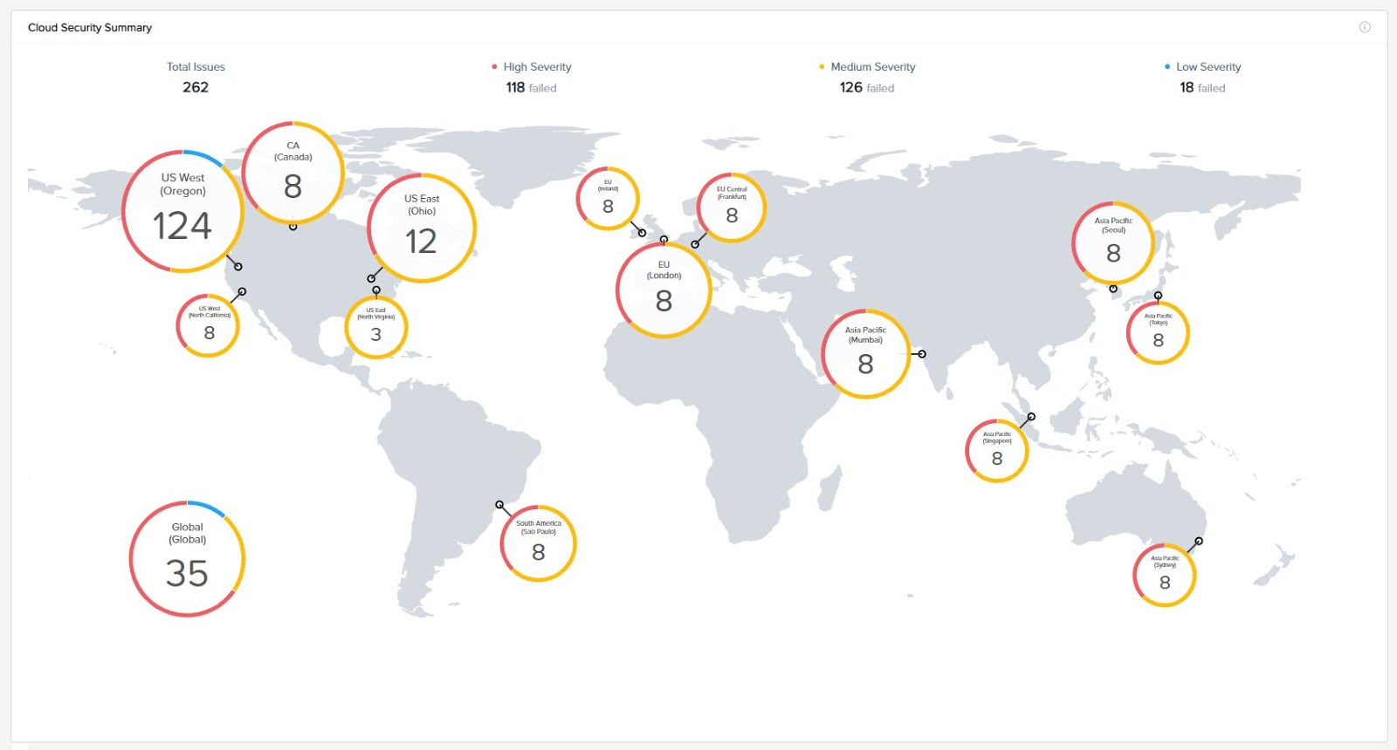
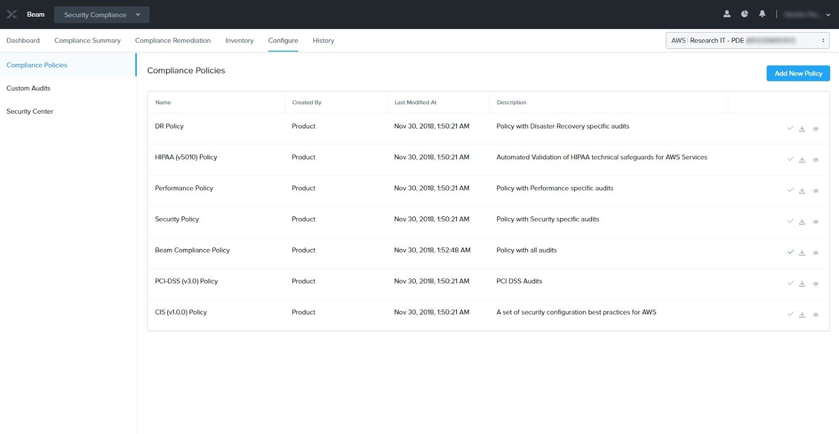
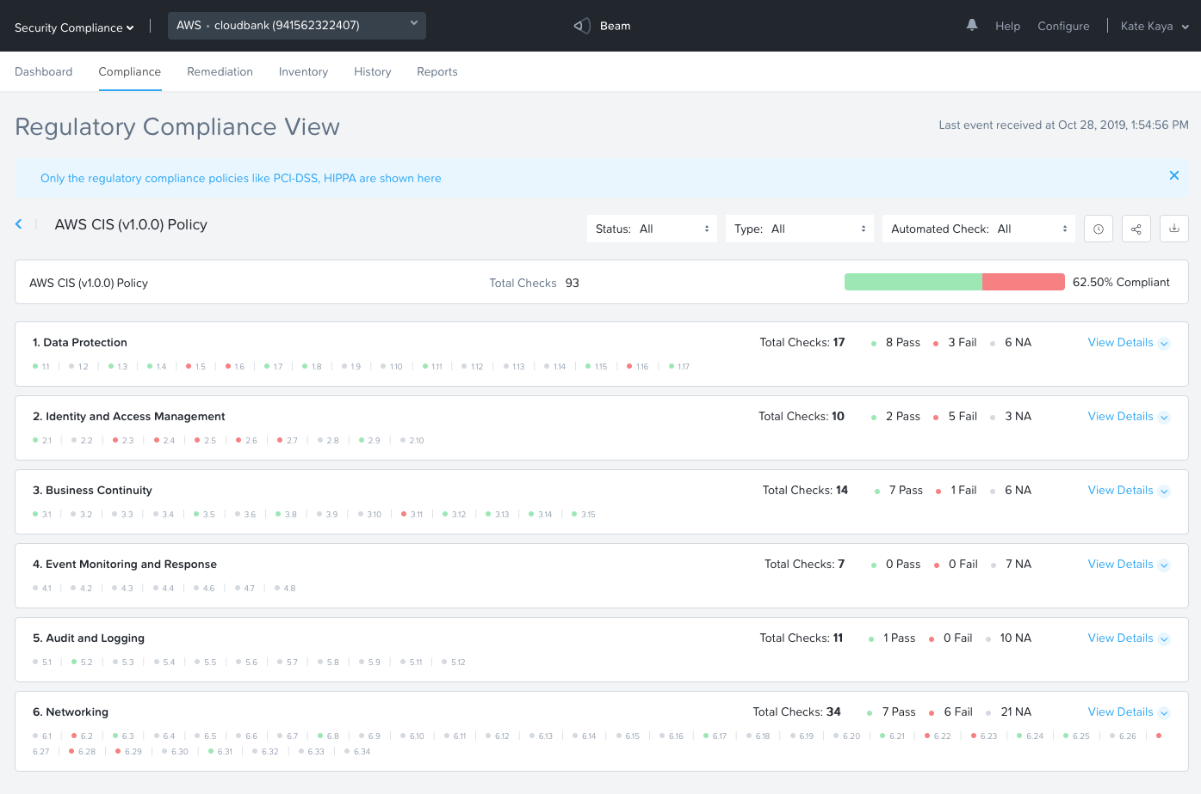
Provides views of instances and compliance to security policies.
Suggests fixes to get an instance into compliance
New Compliance view for all Regulatory policies and Standards. Can set Rule-based alerts to get notified on any specific audit non-compliance as and when they occur.
Out of the box security policies (250+ security checks and can also define your own)

Slide 33
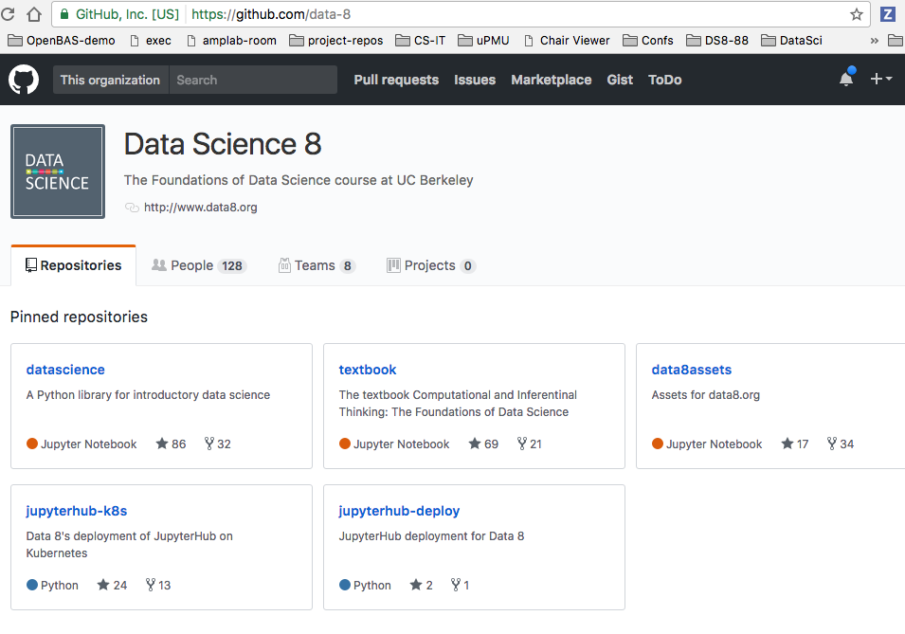
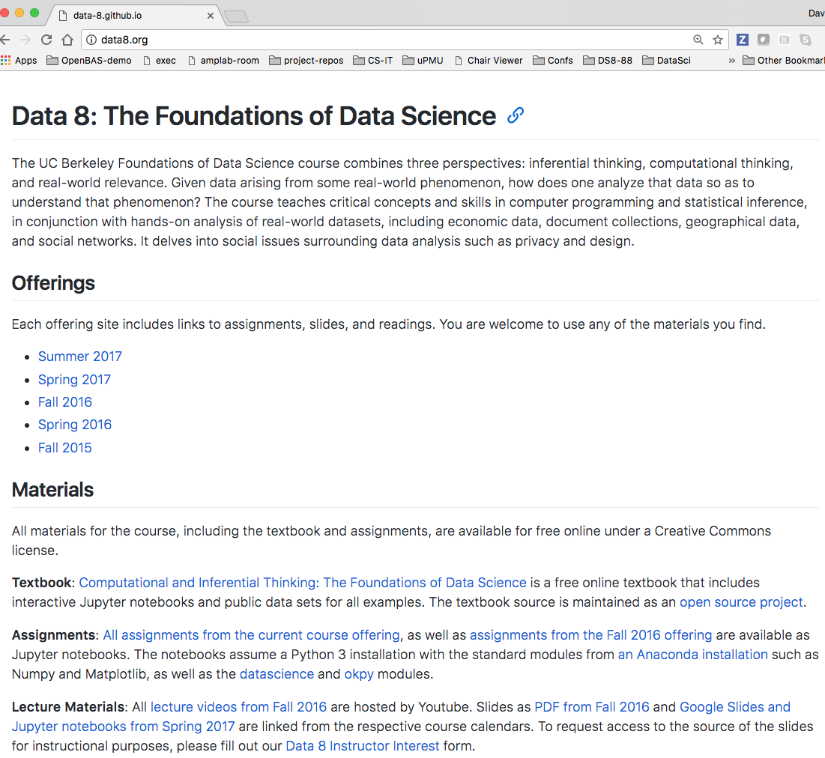
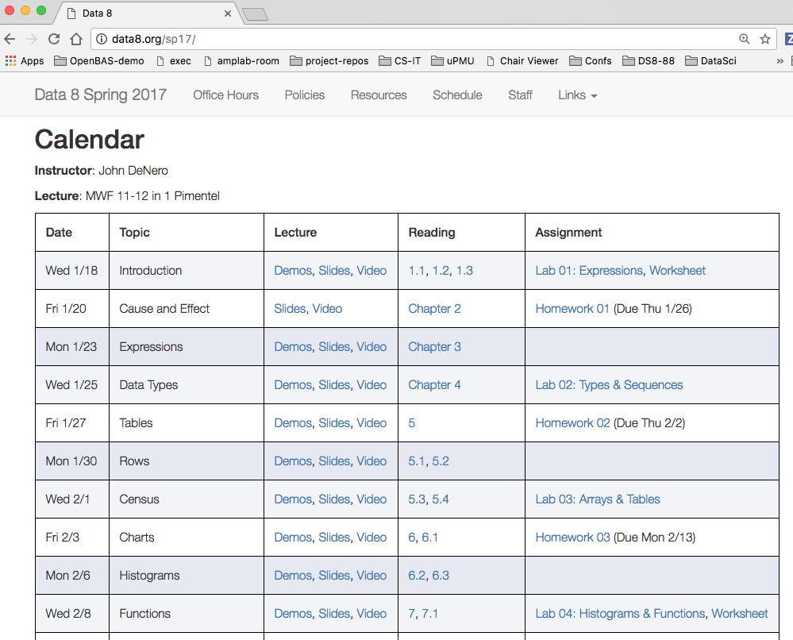
Data8

Slide 34
We are in project Year 1. Production begins in Year 2
Development of user portal
Design & implement workflows: CloudBank, NSF, PIs/users, cloud providers
Integrate usage and account monitoring (Nutanix)
Early user testing
Cloud provider contract negotiation
Education outreach and training
Advisory Board and Center of Excellence formation
Production operations
Operational support for NSF solicitations
PI and user training and support
Annual cloud workshop
Year 1
8/1/19 – 7/31/20
Years 2-5
8/1/20 – 7/31/24

Slide 35
Thank you!
Shava Smallen (ssmallen@sdsc.edu)
Rob Fatland (rob5@uw.edu)
https://www.cloudbank.org
help@cloudbank.org

